Slide 1
Lost Origins

Slide 2
Genre/Gameplay
Lost Origins is a combination of a Role Playing Game and a Hack and Slash game. It emphasises combat to progress through the game.
Features include:
Looting System
Equipment System
Timer if the player wishes to beat their time
Dodging and blocking system, both of these cost stamina.
AI that will manoeuvre around objects and hide thanks to Environmental Query System
When enemies are killed a bar will fill, when this bar is full the boss portal will open.

Slide 3
Story
Lost Origins is based on an island where two clans are at war for leadership. These being: Doomford and Ravenforge.
The playable character called Magma was a gift send many years before to help aid the leader of Doomford with problems that will occur in the future.
Magma later became the adopted son of the leader.
One night members of Ravenforge came and killed the father.
With the help of the war chief Magma will go to the village of Ravenforge and will take matters into his own hands.

Slide 4
Characters
Magma (Playable Character) – Magma has the skills needed to be able to posses both a sword and magic and thanks to training Magma has mastered the use of these to be able to face more than one opponent at the same time.
War Chief – The War Chief is an interactable NPC that will teach the player how the game mechanics work and lead the player in the right direction to complete the game.
Common Enemy – There are two types of common enemies, these being Swordsmen and Mages, these will posses the same skills as the player but instead of having the ability of both each enemy will either be a magic wielder or a sword wielder.
Droghunter (Boss) – Droghunter is the main boss of the game, droghunter should be able to wield both magic and swords like the player can. He will have higher health and will deal more damage to the player.

Slide 5
Levels
There are going to be at least two levels in Lost Origins, these levels being:
The Forest – This is where the enemy village is located and this is where the player will learn how to play the game and will have to deal with most enemies to lead up to the boss fight. Here enemies will spawn in waves which the player will need to use dodges to avoid getting hit, from there the player will slowly take on each enemy. This level is made up of assets going from village assets to different nature assets.
Raven Realm – This is where the main boss fight will take place, it is going to be themed based on a circular arena, this will give the player enough room to deal with enemies and the main boss without making the game impossible to beat.

Slide 6
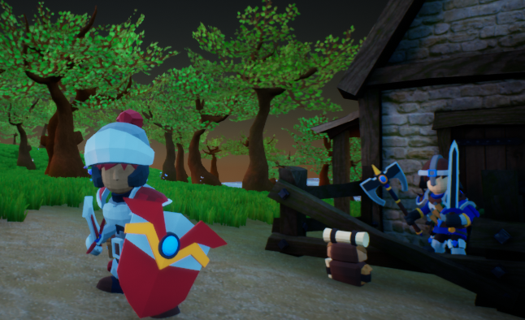
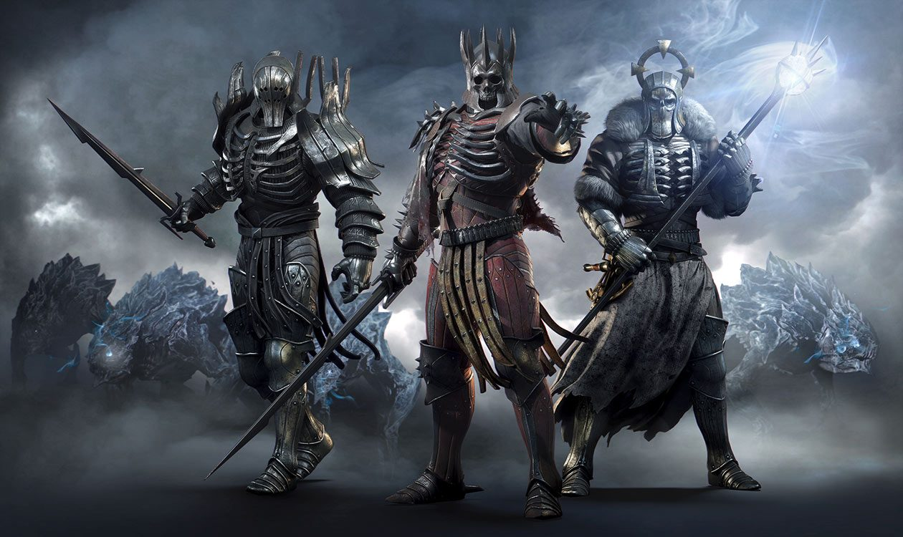
Art
The art style of the game will be based of assets from the unreal asset store.
These will be heavily influenced from games such as The Witcher series and The Elder Scrolls Series.
Other aspects of the game such as the UI will be made using Photoshop to create frames for UI items such as health bars, speech bubbles and icons.

Slide 7
Sounds
There will be many different sounds for different actions that will take place within the game, one of the main sounds within the game is the main music and ambient sounds that will play to try and drown out silence within the game. These sounds will be based upon a fantasy style.
Other sounds include:
The sound of the player getting hit, this is a type of sword slash sound that will only play on a hit.
The sound of the sword swinging and not hitting anything.
The sound of an enemy being attacked is currently the same sound as the sound made when the player is hit.
Magic sounds for the different spells such as burning for fire, and a more holy sound for healing.

Slide 8
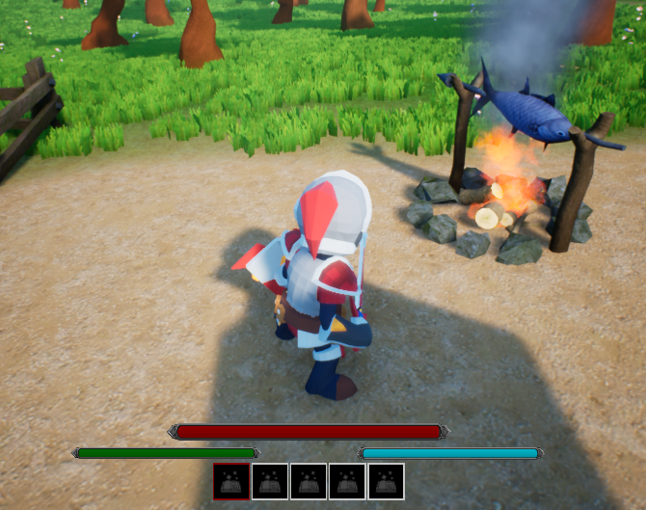
User Interface
The user interface will include different bars and items, these being:
Health
Mana
Stamina
An abilities and item section
Interaction Prompt when talking to NPCs and bags.
Speech bubbles when interacting with NPCs

Slide 9
Controls
The controls of the character will be similar to other games. The W key will cause the player to walk forward, the S key will cause the player to walk backwards, A and D will cause the player to move left and right.
Pressing space will cause the character to roll
Pressing space and shift will cause the character to jump
There will be an interaction key
There will also be an item use key, for example health potions
Left click will be main attack and when combined with shift it will cause a heavy attack.
Right click will be blocking.

Slide 10
Feedback Form Link
https://docs.google.com/forms/d/e/1FAIpQLScDYGgoPm2_hk9Z3_Indttl8_SP9U4aujrFZbBHabgUULMimQ/viewform?usp=sf_link

